Slide 1

Functional Testing services for
Fast Lane Application
Siddharth Mirani
Dated 29th November 2017

Slide 2
Outline
1
Executive Summary
2
Scope & Responsibilities
3
Deliverables
4
Project Milestones
5
Commercials

Slide 3
Executive Summary
Planit is pleased to submit a proposal to AGS and has partnered with them for varied testing requirements which keep coming in from AGS. These projects have been primarily envisaged in the area of functional Testing, Automation, Performance and varied initiatives around different initiatives
Planit is pleased to have been considered for an opportunity to extend this relationship with AGS for their Fast Lane application testing
Our proposal envisages setting up a team which would be embedded within the existing testing team in AGS to carry out functional and user experience testing. This team would be provide support in the area of functional testing as per the product specifications and ensure the quality of product into production post user experience and compatibility testing across multiple device combinations
Planit would deploy testing team for the project with relevant skills and experience working within AGS & Planit premises for this project. This team could work at Planit premises for core functional and user experience testing
We at Planit to complete the functional scope of the project along with Multi device testing within 2.5 months of duration for completing the functional scope of work along with the regression testing for two mobile devices, web portal & simulator. Post that Planit DQA specialist will conduct exploratory testing on multiple devices i.e. 15 devices as agreed with AGS
Planit would charge a fixe fee to AGS a fee of INR of 850,000 for the core Functional testing and multi device testing for the application

Slide 4
Scope & Responsibilities for AGS & Planit
  Scope of Work
Planit will be testing the application across varied devices and performing the below detailed activities
Digital Compatibility Testing
Usability Testing
Digital Experience Testing
Installation and provisioning testing
Below are the devices which we agreed with AGS team and have that execution done to cover the multi device aspect.

Slide 5
Scope & Responsibilities for AGS & Planit
AGS Responsibilities
  Providing the relevant training and introduction to the development team as well as internal AGS stakeholders and giving them walkthrough of the functional flow as planned for AGS
  Planit Responsibilities
  Providing the right team with functional and domain skills specifically for this application and bug tracking and ensuring a quality product being released as per the planned way for AGS
  Leverage components and work packets based upon prior experience with AGS with the objective of increasing productivity and speed

Slide 6
Our team composition for AGS
  For Testing of the Fastlane application a platform we will be testing it onsite i.e. functional testing & device compatibility testing will be done out of Planit premises Planit proposes an ideal team composition for coverage as well as timely completion of the activity which would include atleast 3 rounds of testing based on the deliverables planned as well as the releases/ changes coming in based on the defects identified
  From Sr. Leadership guidance perspective we would be having a team of domain expert & Sr. Delivery leadership along with the delivery heads providing the guidance and driving the work plan for the customer to ensure we stick to the timelines and have quality release being offered to the business in production environment

Slide 7
Sample Reports & Deliverables

Slide 8
Functional Testing Deliverables
Test case documentation
Defect Report
Test Metrics Dashboard
Test Execution report
Test Summary report
Requirement traceability matrix
Exploratory test summary
Risk based test report

Slide 9
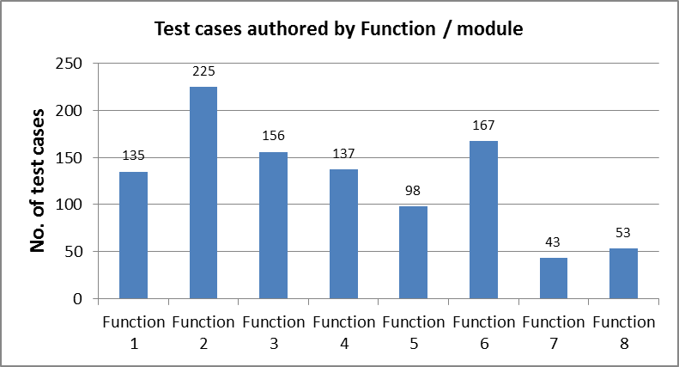
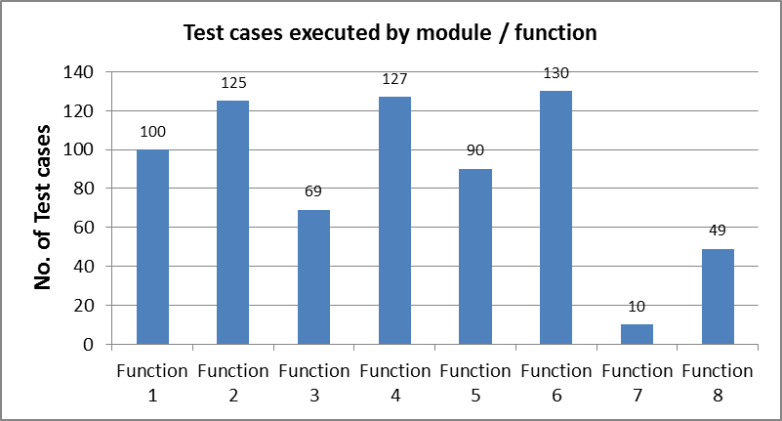
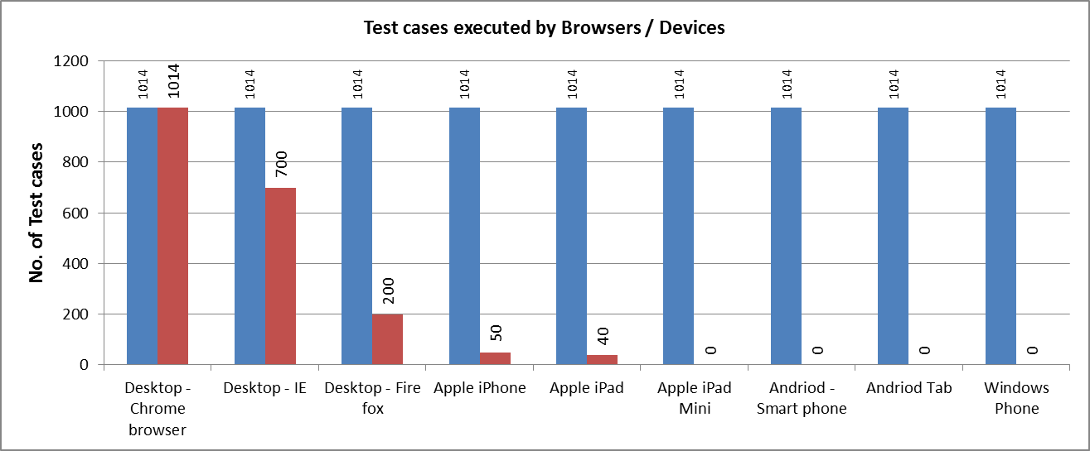
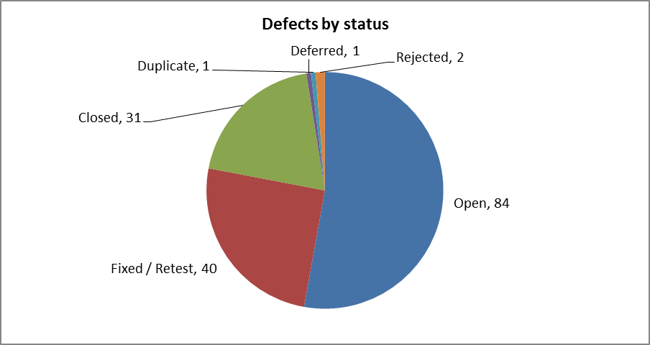
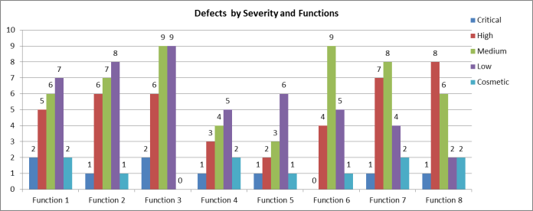
Functional Testing Deliverables- A Sample

Slide 10
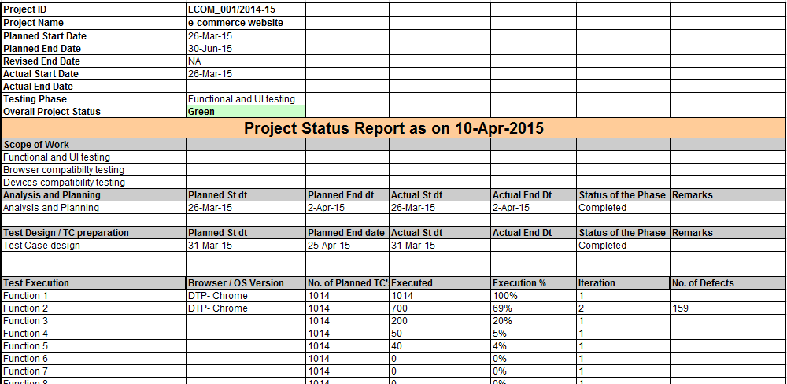
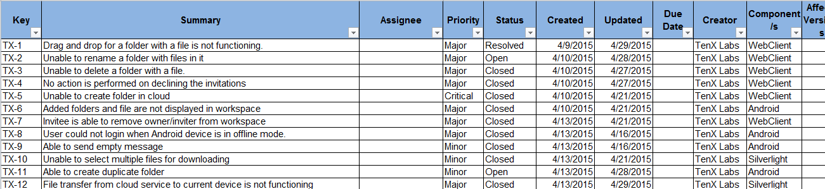
Functional Testing Deliverables- A Sample
Project Status report (weekly)
Defects

Slide 11
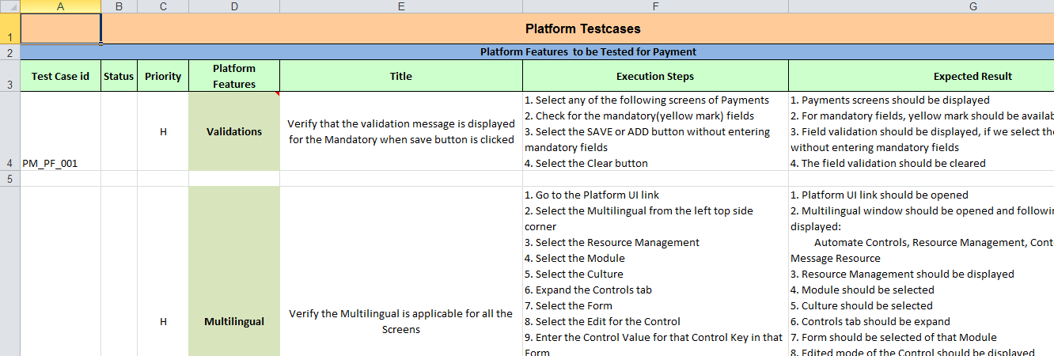
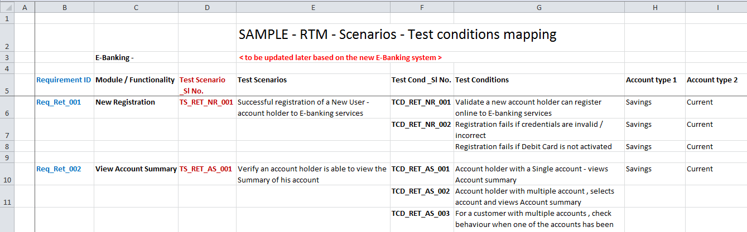
Functional Testing Deliverables- A Sample
Testcase
Test condition

Slide 12
Key Benefits of working with Planit
Planit consultants have a rich exposure in scenario development and optimize in the selection of the right set of scenario’s for maximum coverage
Consistent track record of instant ROI across each execution cycle which helps in faster build deployments
Continuous feedback methodology at each milestone in accordance to the test plan to ensure the solution is updated and having it as a best fit
Value addition across the project life cycle by providing risk based testing approach to minimize the turn around time of executions with maximum coverage to critical functionalities of the application.
Cost reduction – in staff & Infrastructure for devices, Planit deploys ISTQB trained staff. Given Planit has already delivered several projects with this model, it is well equipped to train the staff for specific AGS requirements.
Improved Time to Market-People Interactive can expect quick turnaround for testing to meet the expectations of business
Business Visibility- Enhanced business visibility as well as availability of the application across multiple devices ensuring customer uptime and better market value from a digital standpoint
Reliable On-going Support -People Interactive will able to focus on its core functional without worrying about attrition,
supervision, overheads, people management and other related issues.

Slide 13
Milestones for Fast Lane Project
Training, Scoping & Analysis and Test Case Designing
Functional Testing & Bug Reporting
Regression and Retesting
Functional Testing & Bug Reporting
Week 1
Week 3
Week 8
Week 2
Week 4
Week 5
Week 6
Week 7
Test case Design, Review and Sign-off
Functional Testing & Bug Reporting
Functional Testing & Bug Reporting
Regression, Retesting and Testing deliverables

Slide 14
Timelines & Commercials

Slide 15
Commercials
Based on the discussion which Planit team has had with AGS team we will be able to close this piece of work within 2 months of time at a fixed cost of INR 850,000+ taxes. The fee includes the cost of full time team, support of domain leadership and project management and control. To support the ongoing activity as well the upcoming releases in the near terms. If there is any extension in the project which is beyond control of Planit India we will be charging as per the below rate card.
Payment Terms: We would charge for our services in three instalments
  25% as advance with the PO
  50% upon completion of 1 month of testing
  The remaining 25% would be payable 15 days after the completion of the activity
  Any CR or addition of screens or functional flows will be charged additional @
  The payment for our T&M fees would billed on monthly basis and to be paid within 30 days of raising invoice
Taxes and other statutory duties will be charged as per extant norms. The invoices would be payable net 30 days
Job Title | Experience Years
 |  | Recommended (INR/Month)
Functional Testing
Senior Test engineer | 2-4 years | 85000
Test engineer | 1-2 years | 65000

Slide 16
Commercials
Other Terms
Planit team would work 5 days a week as per AGS timing (i.e.9 hours of standard work hours) and holidays will be followed as per AGS calendar
Planit team would be operating from AGS facilities in Mumbai. AGS would make all arrangements for providing seating, computing infrastructure and other amenities for the Planit team
Any travel if required will be charged additionally on actuals
If any resource resigns from Planit, under such circumstances it will be Planit responsibility to provide a replacement at no additional cost and it will be Planit responsibility to take care of the Knowledge transfer and transition
Any significant over time above this would be chargeable at pro rata basis considering based on agreed amount between AGS & Planit
Planit resource would be eligible for 1 day leave per month, which would be billable and the will also be eligible for all the standard client holidays
Any additional extension or addition of resource to support deliverables will require an additional purchase order to be issued based on the discussion between AGS & Planit
TERM & TERMINATION
The Agreement commences on the Effective Date and continues until terminated by either Party at any time upon thirty (30) days’ prior written notice to the other Party; provided that all the existing terms and conditions in the proposal as mentioned above shall remain in effect

Slide 17
Your Feedback is Welcome
Siddharth Mirani :+ 91-9920126163
siddharthm@planittesting.com

